Slide 1
Ajax 程式設計 Ajax programming Design
張家瑋 博士
助理教授
國立臺中科技大學資訊工程系

Slide 2

Responsive WEB Design
RWD
Bootstrap

Slide 3

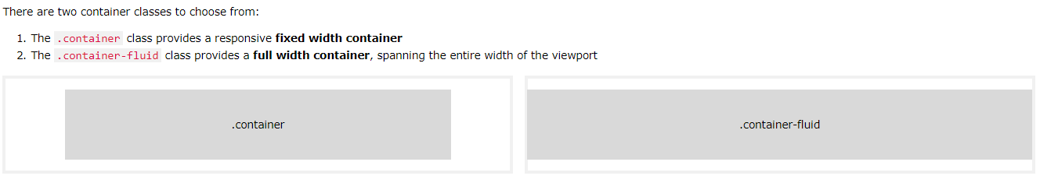
Bootstrap 4 is mobile-first

Slide 4
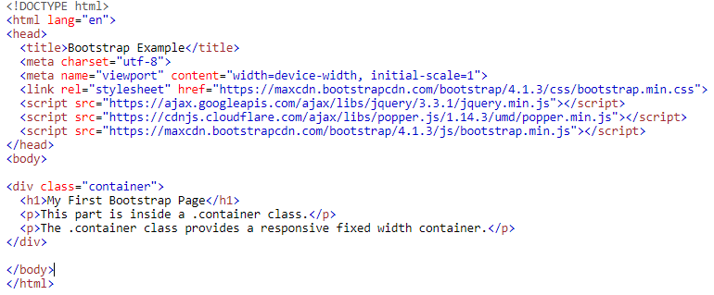
Bootstrap 4 Get started

Slide 5
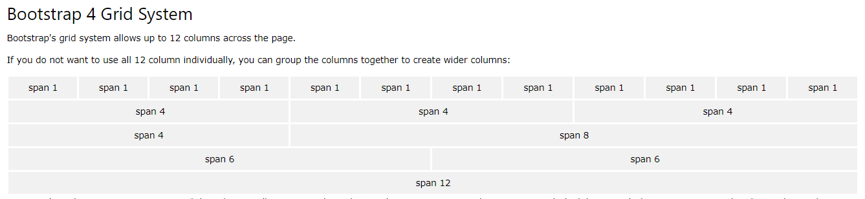
Bootstrap 4 Grid System

Slide 6
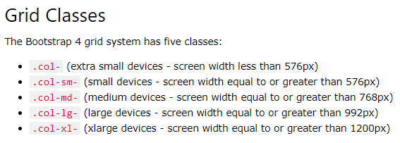
Bootstrap 4 Grid System

Slide 7

Grid Stacked-to-horizontal

Slide 8
Grid Stacked-to-horizontal

Slide 9
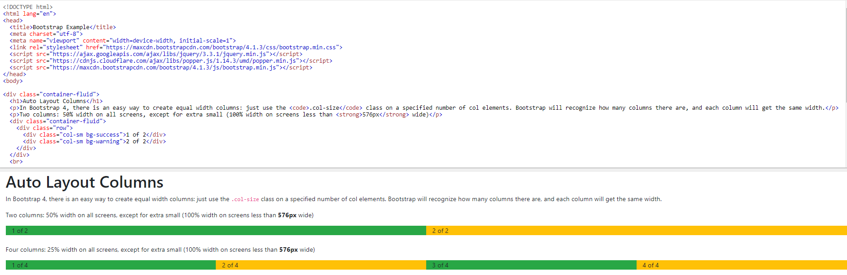
Grid Stacked-to-horizontal

Slide 10
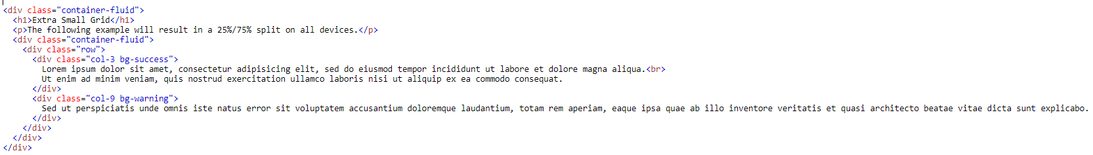
Grid Extra Small

Slide 11
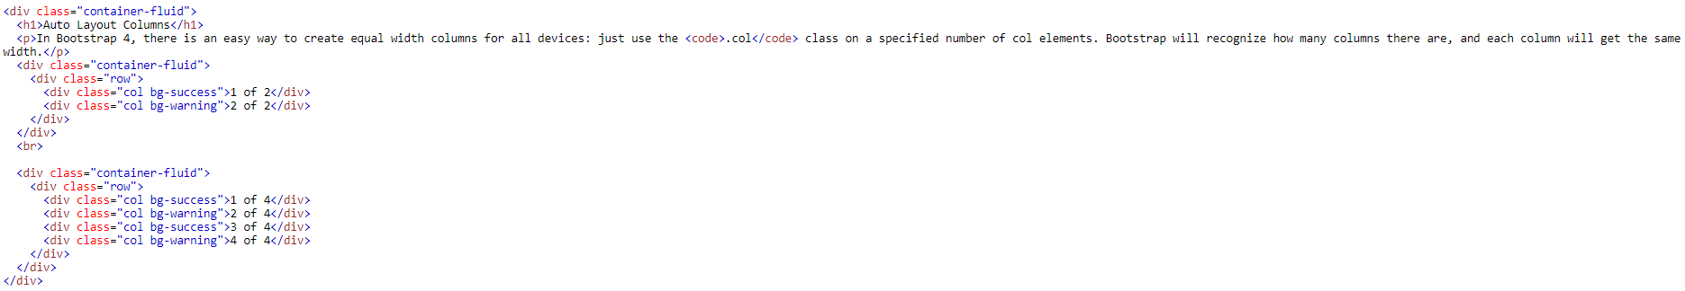
Grid Extra Small
1

Slide 12
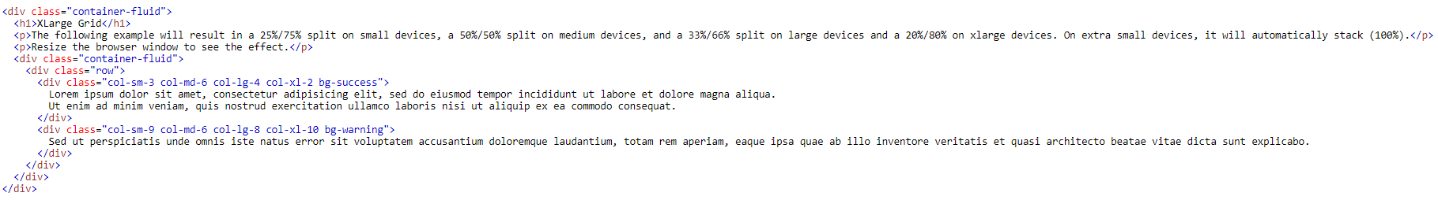
Grid Extra Large

Slide 13
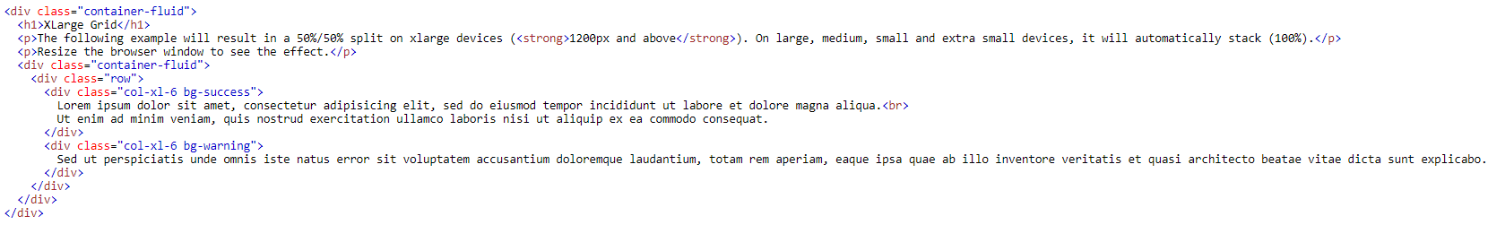
Grid Extra Large only

Slide 14
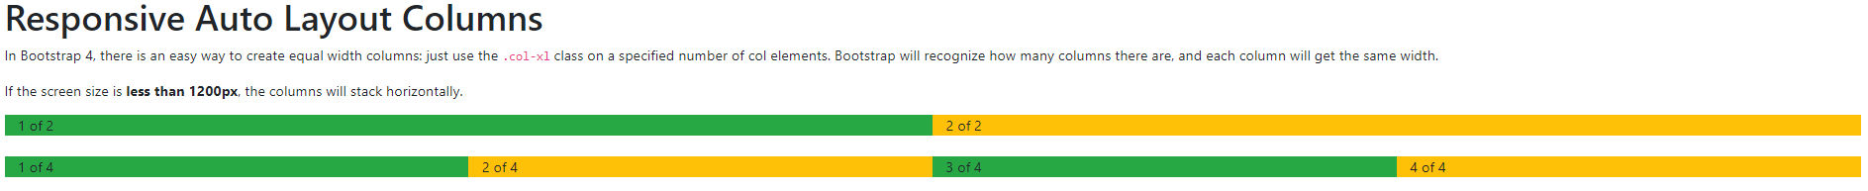
Responsive Auto Layout Columns

Slide 15
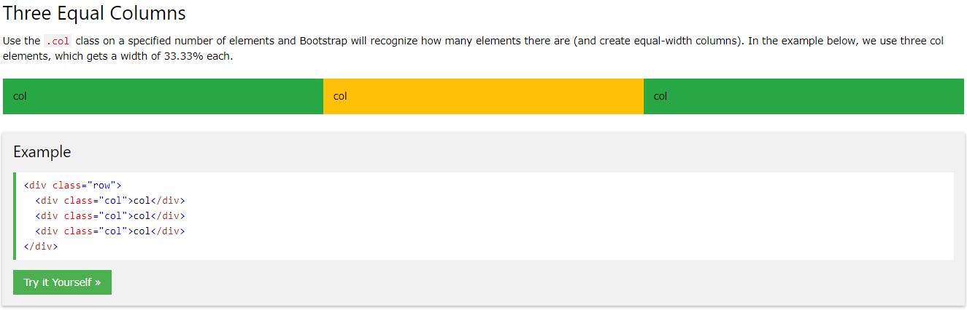
Three Equal Columns

Slide 16
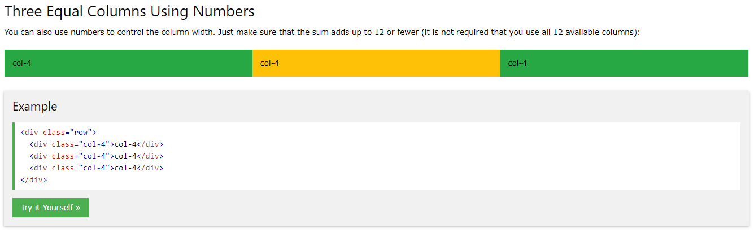
Three Equal Columns

Slide 17
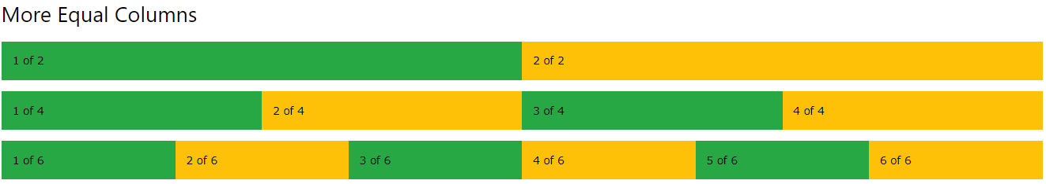
More Equal Columns

Slide 18
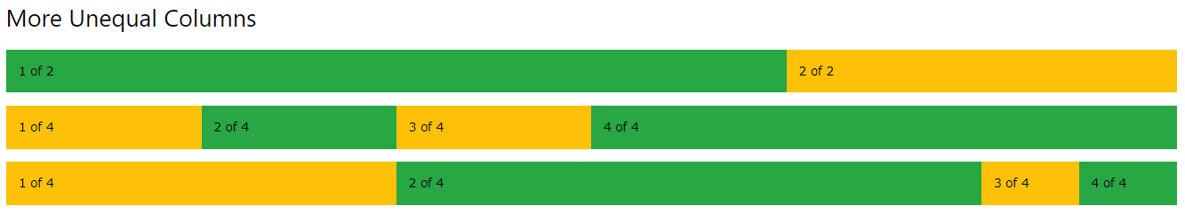
More Unequal Columns

Slide 19
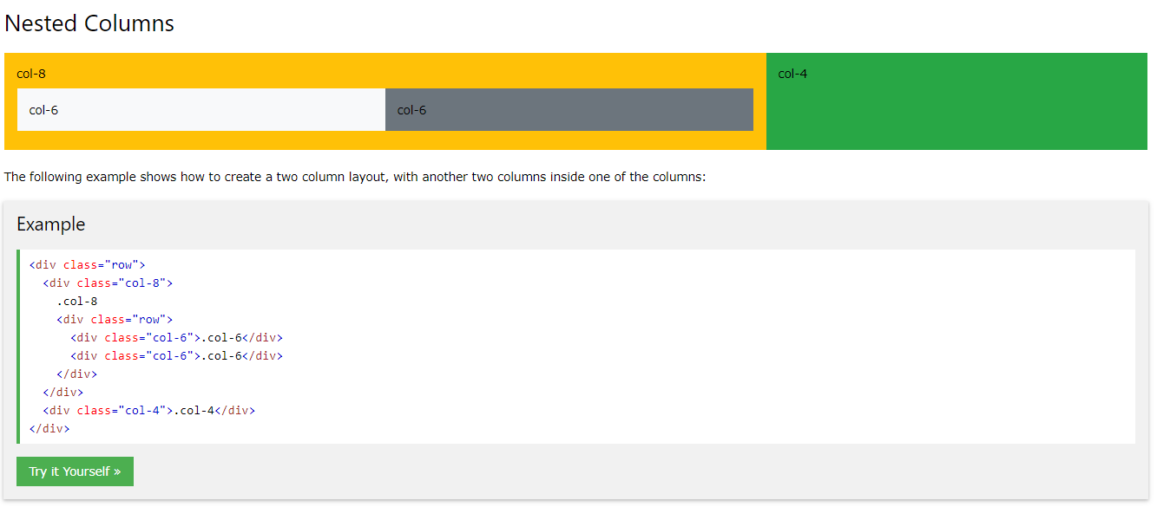
Nested Columns

Slide 20
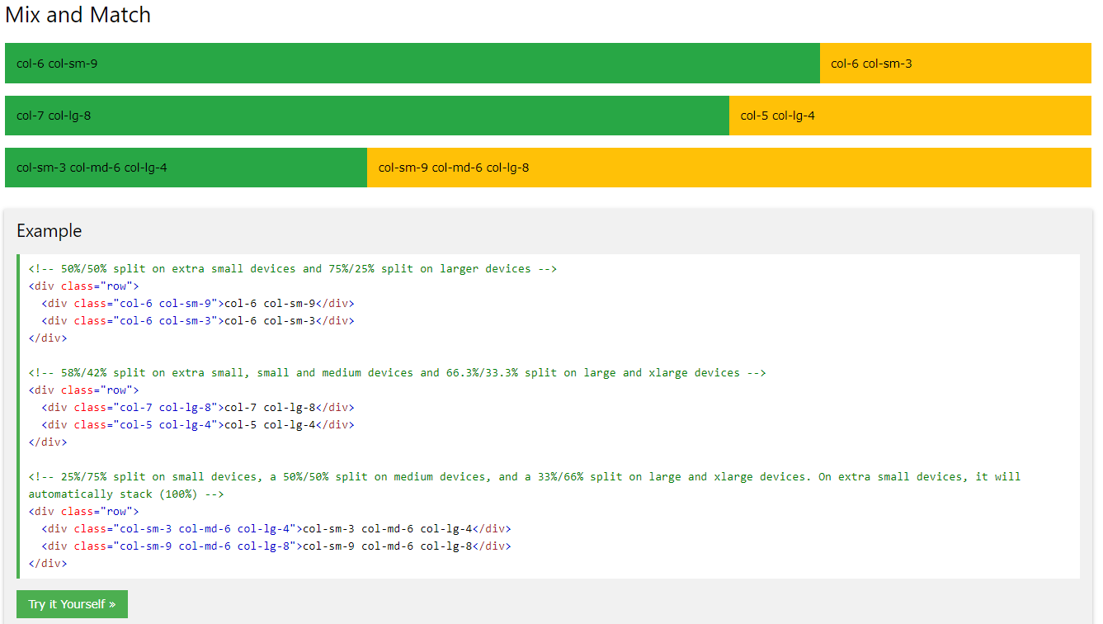
Mix and Match

Slide 21
Thank you
自學資源
W3schools

